Slide 1
Opportunities For SMMEs Under .ZA

Slide 2
Introduction
2
inspire, educate, and equip SMMEs
The .ZADNA concept strategy aims to open up digital opportunities for Black owned SMMEs and enhance South Africa's position as a global leader in the digital economy. There is an increasing number of black youth and SMMEs which is failing to grasp the opportunities around the digital economy -- particularly when it comes to the use of big data and the internet of things (IoT) to innovate and improve productivity.
Domain Industry
ICT Entrepreneurs
Foster the domain name industry ecosystem.
Act as a repository for the domain name system in South Africa.
Grow the number of Black Owned Internet Service Providers (ISPs).
Accelerate the creation of new SMMEs in the [Internet Service Provider/Domain Name Industry].
Notes:
<a href='http://www.freepik.com/free-vector/black-and-white-iphones_755994.htm'>Designed by Freepik</a>

Slide 3
Background
3
ICT for Development
Information and Communication Technology (ICT) is developing at a rapid rate, with more everyday interaction, communication and activity exercised digitally than ever before. In particular, the internet is increasingly regarded as a basic utility much like electricity, gas and water.
Consequently, there is a broad and growing public interest in ensuring access to the internet for all and to ensuring that the evolution of digital technology does not exacerbate the deprivation of people experiencing poverty and inequality.
The internet and digital technologies are transforming our world. But existing barriers mean internet companies and start-ups have their horizons limited, and businesses and governments cannot fully benefit from a digital future.
Since from 1994 Great strides have been made to improve the status and participation of historically disadvantaged people in the formal ICT economy. Unfortunately, Small and Medium Enterprises (SMMEs) still face major challenges while trying to access affordable business management information or training relevant to their needs and local Markets.

Slide 4
Executive Summary
4
The emerging economy in South Africa has seen a substantial growth since the dawn of democracy and the penetration of Information, Communication and Technologies (ICT) has played a role in facilitating the rise of digital entrepreneurs in the townships.
However, Millions of historically disadvantaged entrepreneurs are missing out on the benefits of the digital economy. Exclusion from the digital economy and digital society in which we live in, which if not adequately addressed will further reinforce and deepen the current existing socio-economic landscape in the country. There is therefore, a need for continuous and sustainable transformation that adds value to the economy at large and for the country to realise an inclusive growth.
To unlock the potential of SMMEs, cooperatives and other rural enterprises, to contribute into the South African Economy, the .ZA Domain Name Authority (ZADNA) has developed the [Internet Service Provider ‘ISP’ / Domain Name Registrar Reseller] support programme in collaboration with the Department of Telecommunications and Postal Services (DTPS) to accelerate the creation of new ISPs and support the development and growth of existing SMMEs in the [Internet Service Provider/Domain Name Industry.]
An innovation of ZADNA, developed in partnership with the Dtps, the support programme will address critical barriers facing SMMEs that prevent participation in the formal ICT economy by leveraging the latest information and communication technologies to help historically disadvantaged SMMEs in South Africa learn and implement sustainable start-up business practices, increase their productivity, efficiency and capacity, and improve their access to finance and new markets.
“
Transform lives by creating a centre of excellence in Inclusion through fostering the Black Digital Economy.
”
Notes:
<a href='http://www.freepik.com/free-vector/black-and-white-iphones_755994.htm'>Designed by Freepik</a>

Slide 5
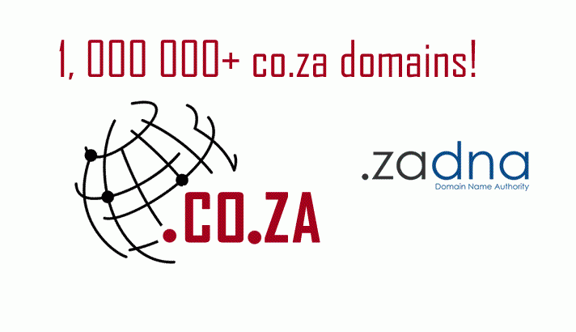
.ZA Domain
5
ccTLD for South Africa
WHAT IS .ZA
ORG.ZA
.ZA is the Internet country code top-level domain (ccTLD) for South Africa. The .ZA Domain Name has a second-level domain (SLD or 2LD) structure - For example, in co.za, CO is the second-level domain of the .ZA TLD.
CO.ZA
.ZA
GOV.ZA
AC.ZA

Slide 6
.ZADNA
6
.ZA Domain Name Authority
Established in 2003, under the ECT (Electronic Communication and Transactions) ACT 2002, to Manage and Regulate the .ZA Namespace.
1
Comply with international best practice in the administration of the .ZA domain name space; license and regulate registries and registrars and publish guidelines on .ZA domain namespace.
2
Public Awareness about the importance of having a .ZA Domain name.
3
Accountable to DTPS with Board of DIrectors appointed by Minister.
4

Slide 7
.ZA Ecosystem
7
Five Rs
Regulator
Registry
Registrar
Registrant
Reseller
Mission
To foster the evolution of a robust and healthy Small Business and Domain Name marketplace in South Africa and the thorough understanding and addressing the local economic development needs of the region and providing an entrepreneurial platform, for business development, collaboration and knowledge exchange.

Slide 8
The Need
8
Why South Africa, 2017
Huge potential
Current Operators
S.A significant population, therefore huge potential
510 Registrar: 409 Local Registrars and 101 international
Gauteng 203
KZN 43
Internet penetration
Western Cape 119
Eastern Cape 18
Fast internet penetration growth yet underutilized capabilities and untapped markets.
Limpopo 3
North West 4
Northern Cape 1
Mpumalanga 4
Marketing Aspects
Encounter challenges with policy making, legal aspects and marketing.
Policy challenges
Lack of awareness
SME Investment
Notes:
<a href='http://www.freepik.com/free-vector/black-and-white-iphones_755994.htm'>Designed by Freepik</a>

Slide 9
Top Registrars
9
9
Top .za Registrars by performance
REGISTRAR
NO. OF DOMAINS
COST PRICE
SELLING PRICE
PROFIT
Registrar A
221,224
R51.30
R89.00
R8 340 144.80
Registrar B
165,004
R51.30
R97.00
R7 540 682.80
Registrar C
83,176
R51.30
R99.00
R3 967 495.20
Registrar D
71,983
R51.30
R75.00
R1 705 997.10
Registrar E
38,250
R51.30
R105.00
R2 054 025
Notes:
<a href='http://www.freepik.com/free-vector/black-and-white-iphones_755994.htm'>Designed by Freepik</a>

Slide 10
TRAINING

Slide 11
CHALLENGES
Entrepreneurial Ecosystems And Growth Oriented Entrepreneurship
ANALYSIS
Increasing the number of high growth firms (HGFs) is now a major focus for industry policy in South Africa. However, existing approaches are proving ineffective. Creating favourable environments for business start-ups is not leading to the creation of more HGFs. And transactional forms of support for HGFs (e.g. financial assistance) are proving to have limited effectiveness.
Policy
Markets
Finance
Human Capital
Culture
Notes:
<a href='http://www.freepik.com/free-vector/black-and-white-iphones_755994.htm'>Designed by Freepik</a>

Slide 12
Learn, Work, Thrive
12
Overview
Internet Entrepreneurship
Project Approach
Rationale
The [Black ISP / Domain Name Registrar Reseller] support initiative:
Entrepreneurship programme
Serving as a Black Center of Excellence
Implemented to foster the Internet Service Provider / Domain Name Industry
Startup Entrepreneurship Ecosystem and
Act as a repository for the SME excellence in South Africa.
Announced as a joint project
Between the Department of Telecommunications & Postal Services (DtpsZA) and the .ZA Domain Name Authority (.ZADNA)
Extended through partnerships with public finance institutions and
with start-up entrepreneurship experts in various fields,
Providing training workshops, material and mentoring programs and
Incubate/ accelerate ISP’s / Domain Registrars Resellers SMMEs
Project will aim to
Contribute to the evolution of the ICT / Internet Service Provision
Evolve Domain Name Market / Industry / Sector in South Africa
Develop a robust and healthy domain name startup ecosystem
Foster collaboration among public and private operators and sharing of best practices and resources.
Notes:
<a href='http://www.freepik.com/free-vector/black-and-white-iphones_755994.htm'>Designed by Freepik</a>

Slide 13
Ecosystem
13
Financial Capital
Policy
Startup Loans
Micro-Finance
Grant funding
Angel Investing
Government Support Regulatory incentives
Institutional Support
Research
Skills
Development
Policy
Finance
Support
Markets
Networks
Early Customers
Entrepreneur Networks
Expertise
References/WOM
Distribution Channels
Supply Chains
Business Planning
Event/Conferences
Working Space
Hubs/Incubators
Legal, Tax, Finance
Markets
Support
Education
Infrastructure
Telecommunications
Transport
Logistics
Notes:
<a href='http://www.freepik.com/free-vector/black-and-white-iphones_755994.htm'>Designed by Freepik</a>

Slide 14
.ZADNA
Services & Support Provision
Together with ecosystem .ZADNA aims to help SMMEs across South Africa to develop capacities and local expertise in all aspects of operation (policy, technical, business and legal). Help applicants to stay informed about future accreditation applications and potential opportunities thereof. .ZADNA will also conduct workshops and training programs.
Not limited to:
Business Development
Registry /Registrar Best Practices
DNS Operation
Domain Names Dispute Resolution
Notes:
<a href='http://www.freepik.com/free-vector/black-and-white-iphones_755994.htm'>Designed by Freepik</a>

Slide 15
APPLICATION
“ICT for Development”

Slide 17
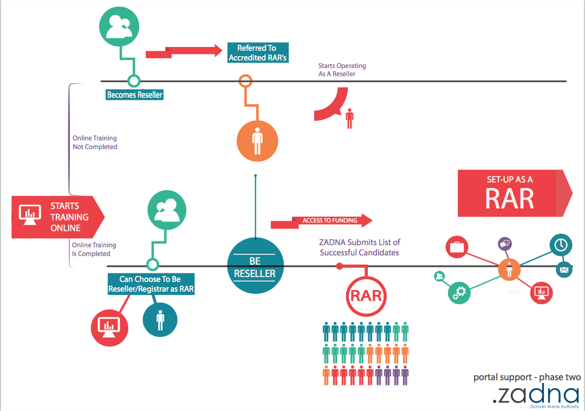

Slide 18
ISP Support Programme
9 Provinces
90 Businesses
365 Days
90 Contracts
1 Goal
Creating a centre of excellence
An innovation of ZADNA, developed in partnership with the Dtps, the support programme will address critical barriers facing SMMEs that prevent participation in the formal ICT economy.
The programme will leverage the latest information and communication technologies to help historically disadvantaged SMMEs in South Africa learn and implement sustainable start-up business practices, increase their productivity, efficiency and capacity, and improve their access to finance and new markets.
Notes:
<a href='http://www.freepik.com/free-vector/rocket-launch-illustration_759862.htm'>Designed by Freepik</a>

Slide 19
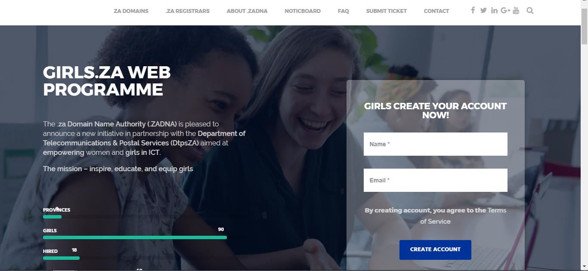
Portal Site

Slide 20
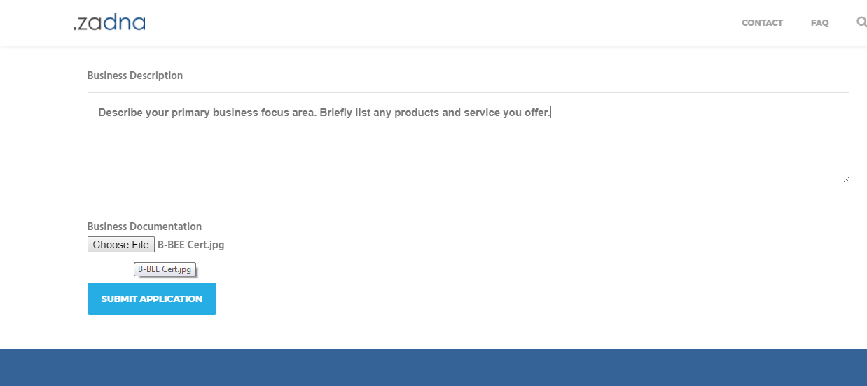
Application Vetting - Legal Docs

Slide 21
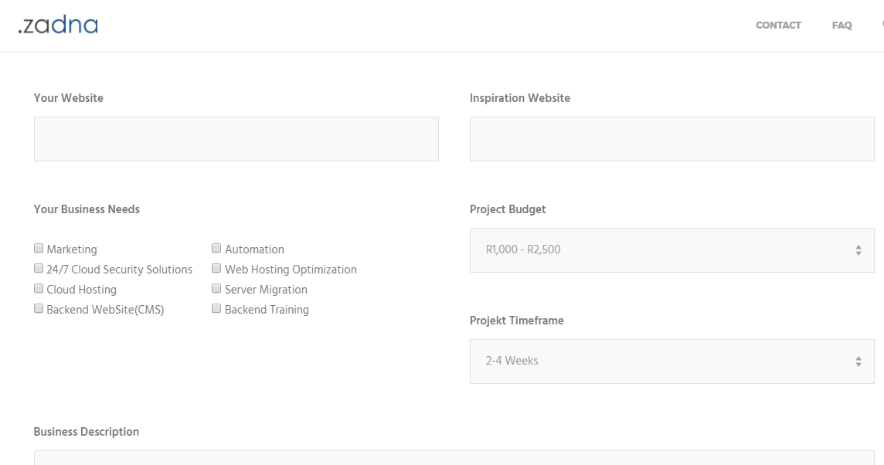
Application Vetting - Needs/Risk Analysis

Slide 22
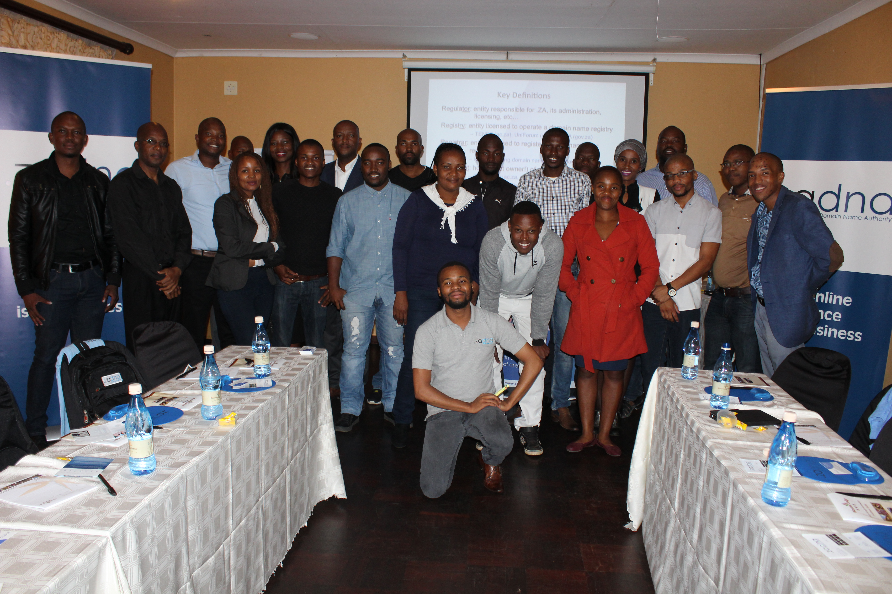

Slide 23
TESTIMONIALS

Slide 24
Philly Marokane
MLData Computer Systems
We managed to greatly reduce our pricing as our registrations and renewal costs drastically went down. We also managed to increase our hosting capacity to accommodate thousands of domains in space and bandwidth as we foresee growth in the near future. To date we have moved more than a 100 domains under our registrar account and growing each month.
“
Before our meeting Limpopo only had once registrar, today I believe we are the second Limpopo based registrar.
”
Notes:
<a href='http://www.freepik.com/free-vector/black-and-white-iphones_755994.htm'>Designed by Freepik</a>

