Slide 1


ICT S SMME REVIEW SYMP0SIUM
SEDA CLIENT JOURNEY

Slide 2


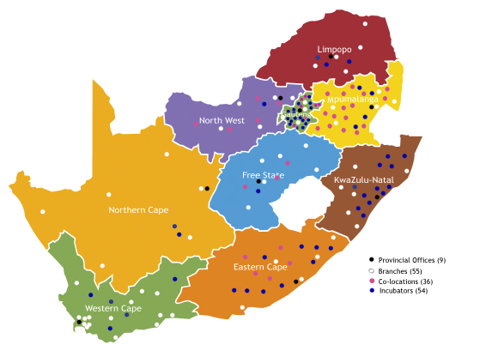


SEDA NETWORK AND SERVICES – Client Journey
Approximate timelines during each stage
National and Local Government Enablers
DSBD, DTI, DST, DHET
1 Month
6 Months – 12 Months
6 Months – 24 Months
6 Months – 36 Months
Assessment
Enterprise Development Services
Selection
Technology Services
Post Intervention
Monitoring & Evaluation
Monitoring and Evaluation and Post-Intervention Support
80+ Seda Branches and Co-Locations
(EDD)
Business
Talk
Assess
Advise
Train
Register
Business
Start
Market Plan
Counselling
Finance
Support
Business
Build
Capacitate
Mentor
Procure
Franchising
Business
Grow
Growth Support
Export Readiness
Manuf. Support
Supplier Dev.
(STP)
Impact
Assessment
Quality & Standards
Quality Systems
Product Testing
Design
Technology Transfer
Capital Equipment
Intellectual Property
Innovation Support
Knowledge Forums
Pitching Competitions
IP Match-Making
ENTERPRISE SUPPPORT NETWORK
Job Creation
Sales Turnover
Assess Select High Potential SMME
Monitor and improve
Skills Transfer
SMME Pipelines
BUSINESS ACCELERATION INITITATIVES
No. of Enterprises
64 + Seda Technology and TVET Incubators
(STP)
Incubation for Start-Ups
Assessment, Selection
Training, Systems, Tools
Offices, Workshops
Shared Business Processes
Market & Finance Plans
Mentoring, Tracking
Technical Labs
Graduation
Virtual Incubation
Support
Monitor
Reporting
R per Job
SABS, Universities,
TIA, Science Councils
R in per R out
Survival Rate
EDD: Seda Enterprise Development Division
STP: Seda Technology Programme
Tools and Partners
Financial Support
Technical and Commercial Service Providers
TOOLS: Company Operations, Critical Planning Exercise, Export Readiness,
Business Canvas and GrowthWheel Mentoring, CRM Tracking, FinFind Matching

Slide 3


THE PROCESS OF COMMERCIALISING TECHNOLOGY

Slide 4


Slide 5
Commercialisation Incubation Models

Slide 6
Partnership Model – NPC+Trust (Sector + programme structure )
Incubation phases

Slide 7
CLIENT JOURNEY
Pre - Incubation
Incubation
Post - Incubation
Idea
Planning
Product Development
Market Development
Launch
Post
Idea Sharpening
Business Planning
Product Development
Market
Launch
Growth
Assessment & Opportunity Recognition
Idea Opportunity Fitment
Idea Market Recognition
Team
Formation
Business Strategy
Business Model Design
Business Plan
Training and Capacity Building
Prototyping
Product Market Test
Seed Funding
Co-Creation & Co-working space
Test Labs / Product Testing
Business Development
Market Entry Strategy
Interfacing with market and investor
Scaling Up
Go To Market
Internal/ External Marketing
PR
Brand
Building
Investor Prepare
and Pitch
Showcasing
Growth Strategy
Africa Growth
Export growth
Digitization
Internationalisation

Slide 8
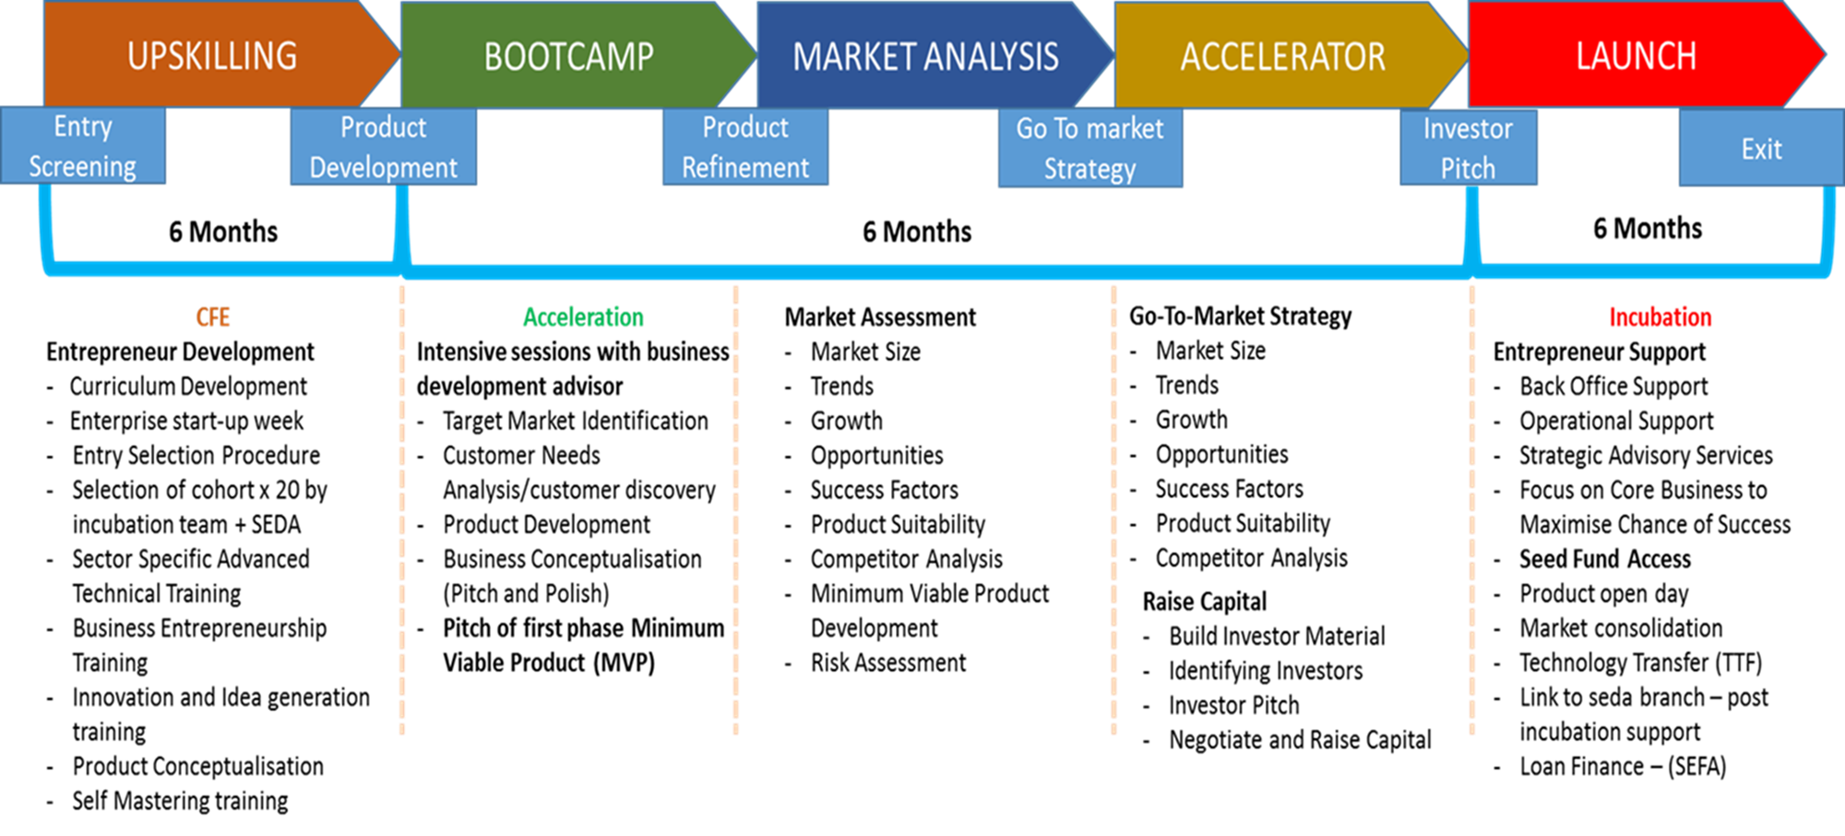
Partnership Model – TVET Colleges & Universities

Slide 9
Seda ICT Incubation Hubs

Slide 10





List of ICT DigitalTBIs Supported by STP – 57 Centres around SA
 | CENTRE | SECTOR | PROVINCE
 | Seda Nelson Mandela Bay ICT Incubator (SNII) | ICT | Port Elizabeth, Eastern Cape
 | INVOTECH | Mixed high-tech | Durban, KwaZulu Natal
 | SoftstartBTI (SBTI) | ICT Digital | Midrand, Gauteng
 | Smart X Change | ICT Digital and Film | Durban Port Shepstone
 | SA French Tech Labs | ICT Digital | Western Cape

Slide 12
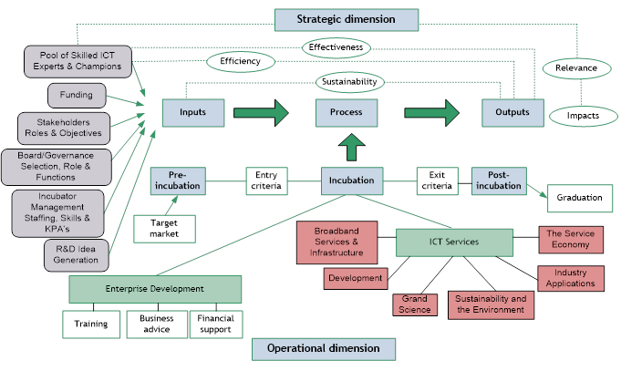
Remodeled ICT Incubator Model

Slide 13
Remodeling and Scale Focus
  Human Capital Development
    Development of ICT Engineering, Coding and Programming skills
  Knowledge Generation and Opportunity Exploitation
    New application generation to solve industry and social challenges
    Digitisation
    Artificial Intelligence
    Robotics
  Knowledge Infrastructure
    Incubation Coding and Programming School
    Incubation Living Labs and Innovation Labs
    High Speed Broadband (free wifi)
    Co-working and Co-Creation Spaces
  Enablers to address the “innovation chasm” between research results and socio-economic outcomes
    Innovation and Technology Commercialization through Incubation

Slide 14
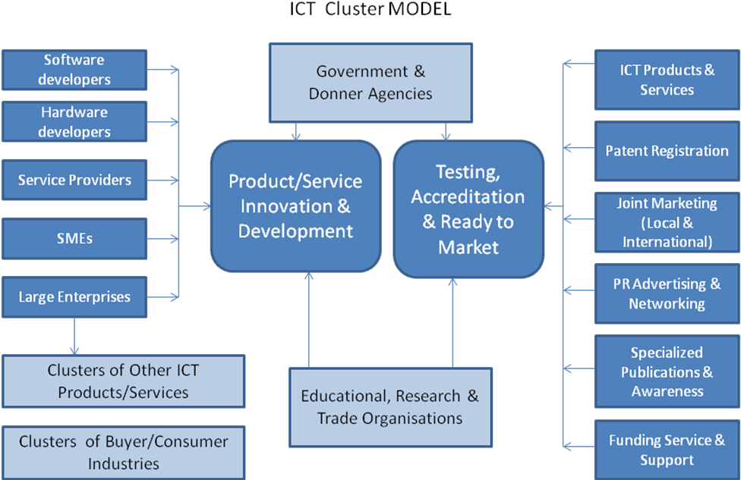
Seda ICT Digital Cluster Model

Slide 15
Seda ICT Incubation Hubs
-Remodelling-
5 Biggest SME ICT Hubs in Africa
Industry 4.0

Slide 16

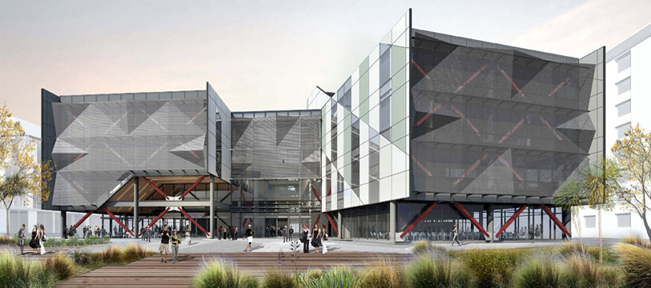
New Conversation
Smartxchange
SNII
5
NEW TECH
HUB
Invotech
SA Tech Lab

Slide 17
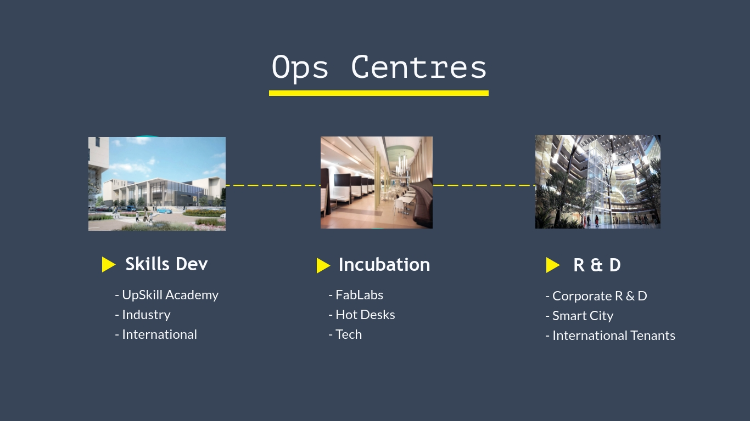

Slide 18
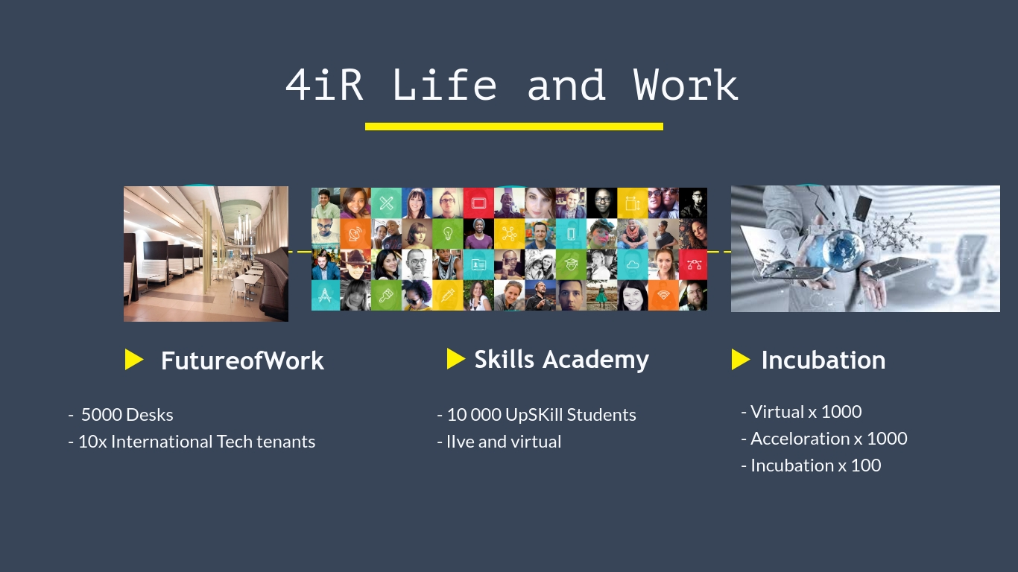

Slide 19
THANK YOU
THANK YOU

